Slide 1
CROP LINK
- Fasal Sena

Slide 2
Topic
Platform that connects local farmers to consumers to reduce food wastage while promoting sustainable consumption.

Slide 3
agenda
Digital marketplace connecting farmers directly with consumers to sell produce, reducing middlemen and food waste in distribution.
Transparency in farming practices and produce origin empowers consumers to make informed purchasing decisions.
Efficient logistics optimize transportation, minimizing environmental impact.
Surplus management features facilitate sale of excess or imperfect produce, reducing waste.
Consumer education resources promote sustainable food choices, fostering a more efficient food system.

Slide 4
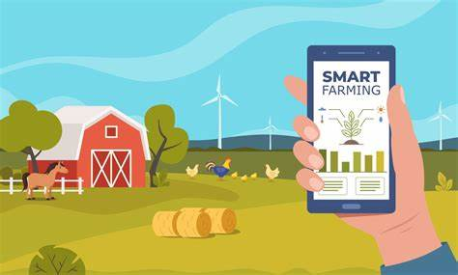
What are the solutions?
Create a website that links the local farmer and consumer directly so that there is no middle man and there is less food waste as farmers can directly sell to consumers avoiding stores storage.

Slide 5

Brainstorming
Discussing the basic ideas of how to deliver the website and mapping the websites

Slide 6
Working of the website
The website functions a farmers and consumers aiming to combat food wastage while promoting sustainable consumption.
Upon landing on the main page visitors are greeted with informative content dealing various methods to reduce food wastage
Once user decides to engage further, they are prompted to login , where they can register as either Consumers or Farmers.
Once registered (as consumers) they encounter a range of options categorized by product types such as vegetable , Fruits etc.
Once registered (as farmers) they can upload options of product with their quantity and price , also they can add an image to it.

Slide 7

Creating a Website: Step-by-Step

Slide 8

1. Selection of Base Language (Python)
Readability: Python's syntax is designed to be clear and readable, making it easier to write and understand code. This readability reduces the cost of program maintenance and development.
Versatility: Python is a versatile language, suitable for various applications such as web development, data analysis and more.
Integration Capabilities: Python can easily integrate with other languages and platforms. For example, it can be embedded in html ,css etc.

Slide 9
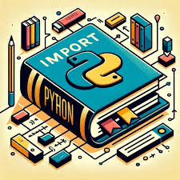
2. Imports:
The code starts with importing necessary modules and packages:
"message" from "email" module
"Flask" and related modules (render_template, request, redirect, url_for, session) for creating a web application
"SQLAlchemy" for working with databases
"datetime" for handling date and time
"Bcrypt" for password hashing
"Admin" and "ModelView" from "flask_admin" for creating an admin interface

Slide 10

3. Initializing Flask App:
An instance of the Flask application is created with the name app, and a static folder is specified so that there is a direct link between the static file and image could be retrived from it.

Slide 11
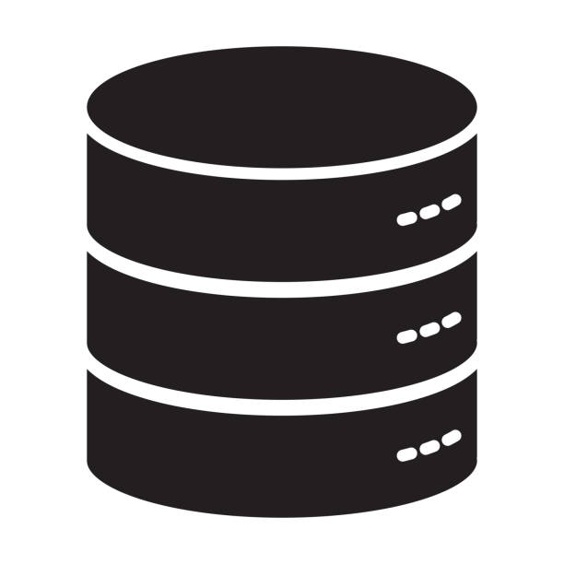
4.Configurations:
"SQLALCHEMY_DATABASE_URI" is set to a SQLite database file named "hackathon.db" to store the data.
"secret_key" is set for securing session data.

Slide 12

5. Database Models:
Two database models are defined using SQLAlchemy: “User” and “UserCredential”.
User model represents users with attributes like “user_id, user_name, and user_type”.
UserCredential model stores user credentials with attributes “cred_id, user_id, and password_hash”.

Slide 13

6.Templates
Specific templates are stored in this specific folder which render as and when required.
These codes are written in html and designed with the help of css.

Slide 14
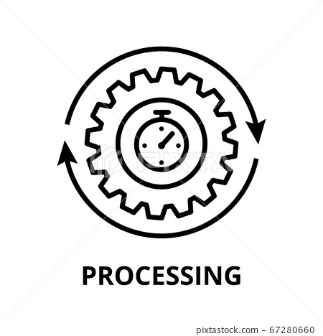
7.Routes:
'/': Renders the index.html template.
'/login': Handles user login. It accepts both GET and POST requests.
'/forgot_password': Renders the forgot_pass.html template.
'/signup': Handles user signup. It accepts both GET and POST requests. On GET, it renders the signup.html template, and on POST, it adds a new user to the database after hashing the password.
'/logout': Logs out the user by removing session data and redirects to the index page.
'/farmer/dashboard' and '/consumer/dashboard': Renders the dashboard templates for farmers and consumers respectively, but only if the user is logged in and has the appropriate user_type in the session.

Slide 15

8. Main Block:
The application is run if the script is executed directly.
This program creates a Flask web application with user authentication, user registration, and basic dashboard functionality for different user types (farmers and consumers).
It uses SQLAlchemy for database interaction, Flask-Admin for the admin interface, and Bcrypt for password hashing.

Slide 16
References
https://images.google.com
https://stackoverflow.com/
https://www.geeksforgeeks.org/
https://github.com/
https://stackexchange.com/
https://medium.com/
https://gemini.google.com/app
https://chat.openai.com/
https://edu.gcfglobal.org/en/
https://www.youtube.com/
https://docs.oracle.com/en/database/oracle/

Slide 17

Final tips & takeaways
Use locally available foods
Avoid middleman
Find ways to connect to local farmers
Explore new techniques
Timing and transitions are important
Accept the transitions
Avoid wasting food
Refer to colleagues to listen & provide feedback

Slide 18
Thank you
Fasal Sena
-Sohan Rane
-Om Minche -Abel Fernendes
-Abhishek M

